Slide 1
Sonoma County
Area Agency on Aging Advisory Council
04.30.2024: Sonoma County Aging & Disability Commission
New Member Orientation
April 17, 2024

Slide 2
Welcome!
Area Agency on Aging
Advisory Council
Jenny Helman, Vice Chair
Deanna Shaat, Secretary
Area Agency on Aging
Community Services Program Manager
Katie Parrish, Outgoing
Sara Avery, Incoming
Notes:
Paul: acknowledge past 6-8 months have been challenging and we’re ready to move forward with renewed clarity.

Slide 3
Land Acknowledgement
Land Acknowledgement
The County of Sonoma recognizes that we’re on the ancestral lands of the Coast Miwok, Pomo and Wappo who are the original caretakers of this area. We respectfully acknowledge the Indigenous peoples who continue to steward and maintain relationship on this land as knowledge keepers.

Slide 4

Agenda
Where You Fit In
Opportunities to Learn
Overview
  Aging & Disability Network, Service Network
  Sonoma County Demographics
  Area Plan Needs Assessment
  Human Services Department: Adult & Aging Division and the Area Agency on Aging
  Area Agency on Aging Advisory Council soon to be renamed the Sonoma County Aging & Disability Commission
Notes:
Katie introduces the presentation overview: there is so much to say – we have focused on what was most beneficial – key parts of the story.

Slide 5
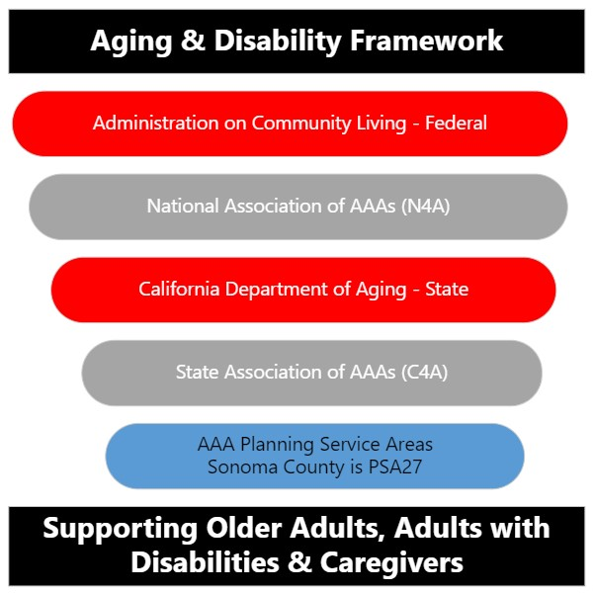
Aging & Disability Network – High Level
California Commission on Aging
https://ccoa.ca.gov/
Triple-A Council of California https://tacc.ccoa.ca.gov/

Slide 6
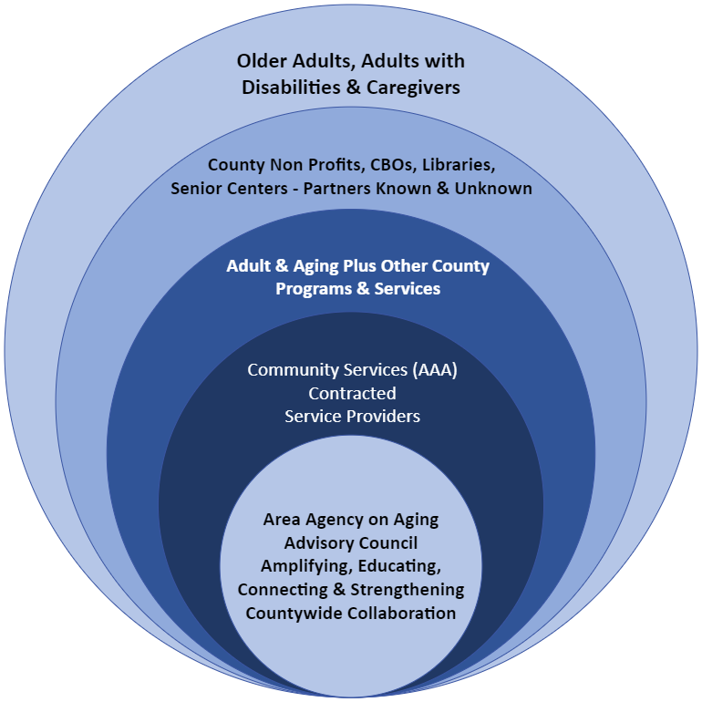
Service
Network

Slide 7
2024-2028 Area Plan
Being approved by the Board of Supervisors on April 30th.
Available to access on the Advisory Council Landing Page
This link will be updated once the Commission is renamed and
webpage is updated.
Read, Absorb, Ask Questions

Slide 8
Sonoma County Demographics
Amplify!

Slide 9
# OLDER ADULTS & PROJECTED
CURRENT
Age N = 60+ % of 60+
60 – 64 39,732 27%
65 – 69 31,327 25%
70 – 74 31,722 19%
75 – 79 16,503 12%
80 – 84 11,584 7%
85+ 11,264 9%
28% of the Population
Total population of Sonoma County 492,498
Total population of people age 60+ 138,132
% of people age 60+ 28%
PROJECTED
35% of the Population by 2030
Total population of Sonoma County 521,303
Total population of people age 60+ 182,459
% of people age 60+ 35%

Slide 10
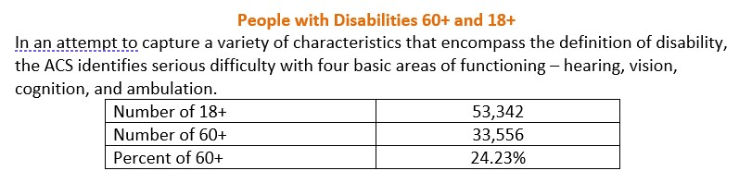
Demographics of Sonoma County

Slide 11
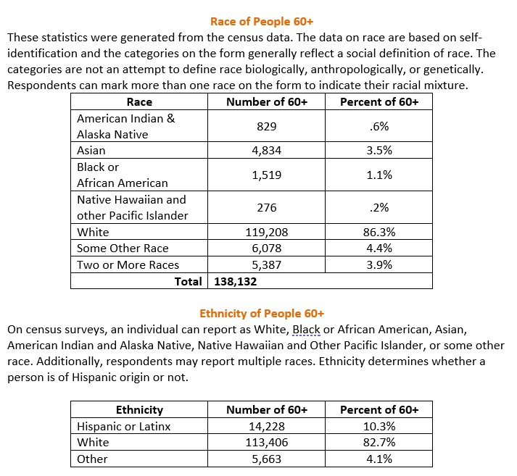
Demographics of Sonoma County

Slide 12
Priority Populations Served by Funding
Older adults 60+, adults with disabilities and their caregivers
  Greatest Economic Need: income level at or below the federal poverty level
  Greatest Social Need: noneconomic factors that restrict and individuals’s ability to perform daily tasks or ability to live indendently:
    Physical or mental disability
    Language barriers
    Cultural or social isolation caused by racial and ethnic status, sexual orientation, HIV status, gender identify or gender expression.
Notes:
While we recognize that 28% of the population is over the age of 60 and 53,342 individuals over the age of 18 are living with a disability, the target population to be served by these funds are those who meet these two definitions established in the Older Americans Act and California’s Welfare & Institution Code.

Slide 13
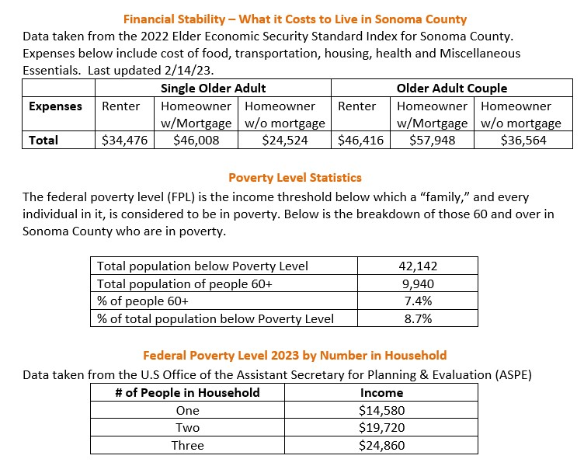
Financial Insecurity
Notes:
Given the definition of economic need highlighted in the previous slide, we believe it’s important to amplify the dissonance between the Elder Economic Security Standard Index for Sonoma County and the Federal Poverty Level.

Slide 14
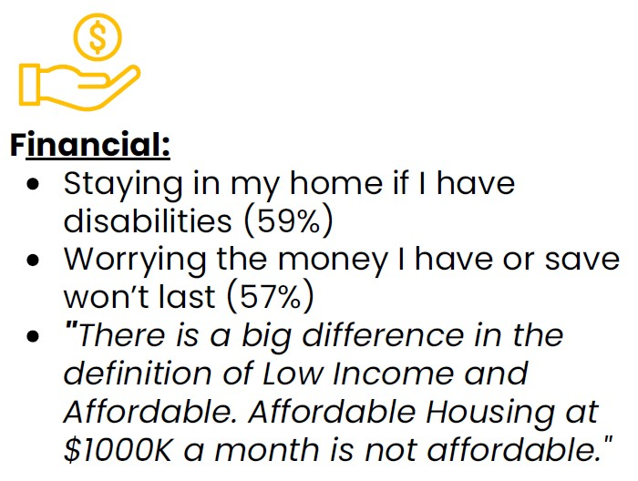
Financial Insecurity in Sonoma County
California has the highest rate of senior poverty in the nation. Older adults are struggling to make ends meet and stay in their homes, especially in the areas of California with the highest housing costs. Homelessness among California seniors is on the rise.
Justice in Aging
Needs Assessment Priority Area:

Slide 15
Area Plan:
Needs Assessment Priority Areas & Survey Demographics
Notes:
Remove caps

Slide 16
To Identify Funding & Initiative Priorities for the County
Needs Assessment
Surveys: 1,679
Online and Paper
English 1,565 Received
Spanish 114 Received
Focus Groups: 14
Targeted groups included low-income housing communities, Spanish-speakers, Rural/Geographically isolated areas, Urban Areas, LGBTQIA+, Alzheimer’s Disease & Caregivers, People with Disabilities & Caregivers.
Stakeholder Interviews: 43
Leaders from Community Services & Supports, Health, Transportation, Housing, Caregiving, Emergency Preparedness, Protection from Abuse, and Economic Security.

Slide 17
Needs Assessment 2024 – 2028
Top Concerns
Caregiving
Health & Nutrition
Housing & Transportation
Access to Services
Financial Stability

Slide 18
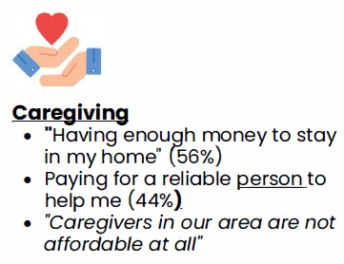
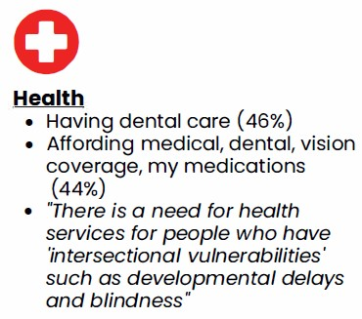
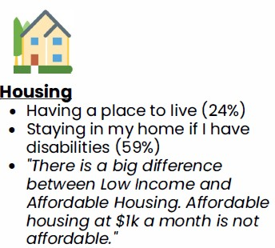
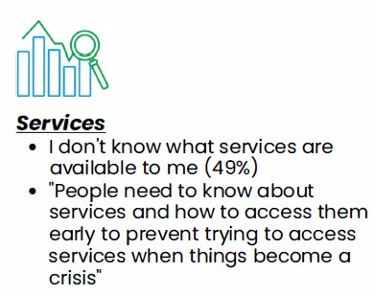
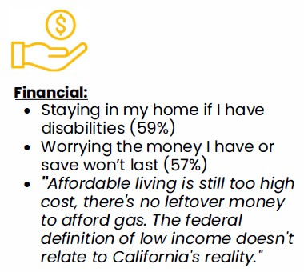
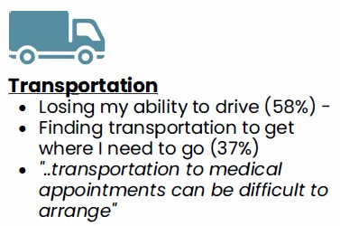
Top Concerns: Survey & Focus Group Details

Slide 19
Human Services Department
Adult & Aging Division and the
Community & Administrative Services Section

Slide 20
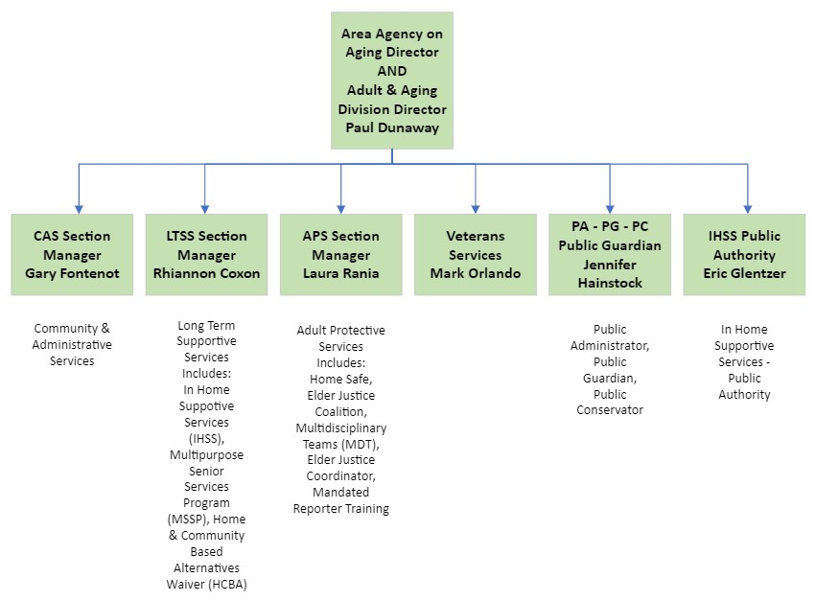
Notes:
Shani should produce this.

Slide 21

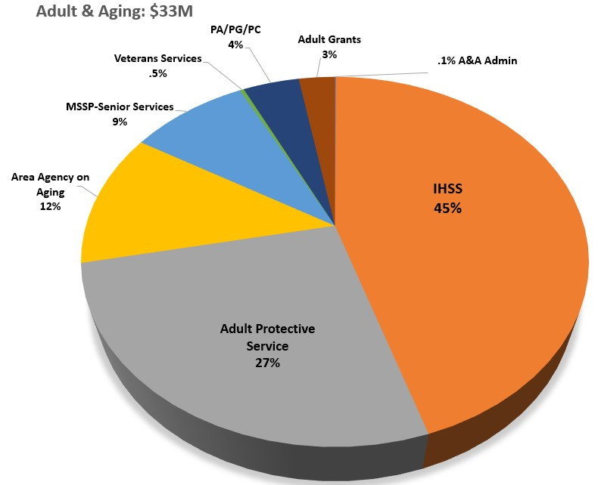


Adult & Aging Budget & Services
High Level View
Nutrition*, Transportation,
Caregiving, Safe Mobility
Case Management, I&A
Etc.
Public Authority
Notes:
Pie chart shows IHSS 45% or so and APS huge chunk and then how small community services with older americans act is even smaller. Demonstrates the missed opportunity for what all there is to talk about. Paul: this is just adult and aging and doesn’t include all the work of other CBOs and other community organizations and municipalities. Not perfect numbers. Add footnote: approximations.

Slide 22
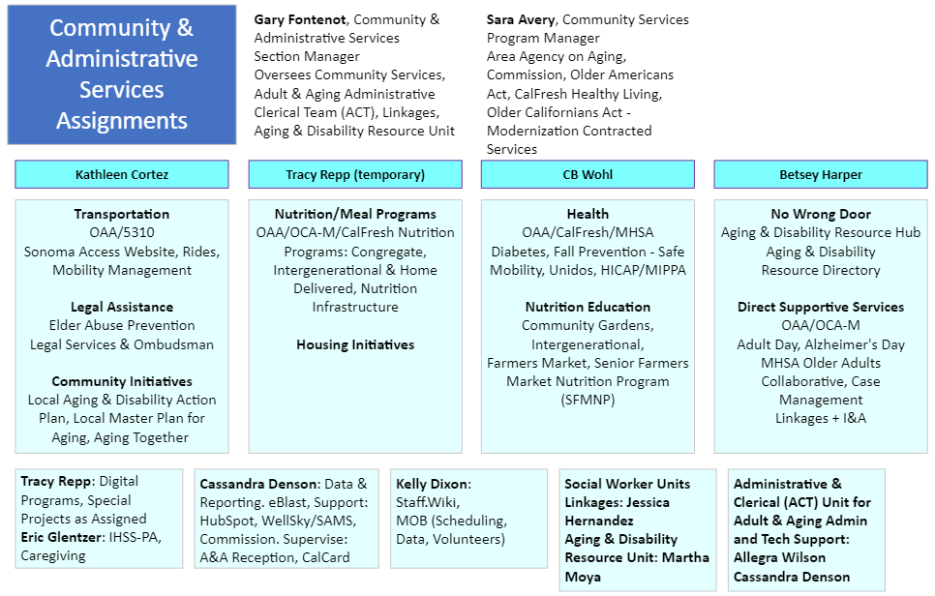

Slide 23
Examples of community partnerships leveraged by Area Agency on Aging
Healthcare and social care integration
Access to Service through “No Wrong Door”
Mental Health
Elder Justice & Elder Abuse Prevention
Fall Prevention – Safe Mobility
Notes:
Healthcare and social integration – reference 7 year partnership with Petaluma Health Center, MHSA funding partnership with SRCH, and now emerging discussions with WCHC to place a Linkages social worker – tie in Cal AIM
Development of Information and Assistance over the past 5 years into a robust call center that is now at the heart of the Aging and Disability Resource Hub (ADRH) – we’re working on a no wrong door system for Sonoma County’s older adults, people with disabilities, and caregivers
Older Adult Collaborative for 10+ years _ Healthy IDEAS – IHSS screens for depression (unique in the State) –
Transportation ?
Caregiving?
Nutrition – CalFresh Healthy Living?
Elder Justice – partnership with SAS – Elder Justice Coordinator at County level
Fall Prevention – Matter of Balance – Dignity at Home

Slide 24
Countywide Initiatives
Aging & Disability Resource Hub (ADRH) “No Wrong Door”
Local Master Plan for Aging (part of Aging Together)
Local Aging & Disability Action Plan (LADAP)
Age-Friendly & Blue Zones

Slide 25
Area Agency on Aging
Advisory Council
What is Your Why?
How Will You Engage?
How Can We Support You?

Slide 26
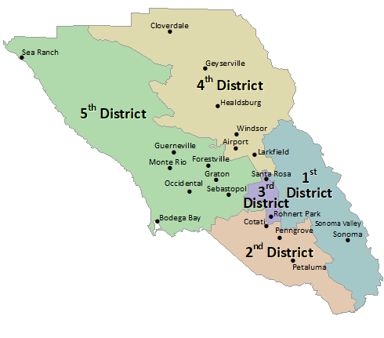
Sonoma County Area Agency on Aging (AAA)
Planning & Service Area 27
21 Advisory Council Members
Know Your
District
District 1 Supervisor Gorin
District 2 Supervisor Rabbitt
District 3 Supervisor Coursey
District 4 Supervisor Gore
District 5 Supervisor Hopkins

Slide 27
Advisory Council Statewide Structure
Sonoma County Area Agency on Aging Advisory Council soon to be the Sonoma County Aging & Disability Commission
California Commission on Aging (CCoA)
CCoA serves as the principal advocacy body for older Californians and as a catalyst for change that supports and celebrates Californians as they age. Administers TACC.
CCoA Values: 1. equity & inclusion 2. autonomy, choice & access 3. respect & integrity 4. collaboration & partnership. 25 appointees. Appointed by the Governor, Speaker of the Assembly & Senate Rules Committee
Chair of the Advisory Council or their Delegated representative participate in Quarterly meetings. TACC mission is to promote communication and collaboration among advisory councils and key state partners.
Triple A Council of California (TACC)
Educate through exchange of information 2. Advocate on issues of concern in local/state planning
3. Strengthen the advocacy effectiveness and leadership skills of local advisory councils.

Slide 28
Structure of the Commission
Commission – 21 Members
  10 members Board Appointed, 2 from each Supervisorial District
  11 members Commission Elected
  Meetings 3rd Wed: Sept-Oct-Nov, Jan-Feb-March-April-May-June (no mtg Dec/July)
  Planning Day in August on the 3rd Wed (typically 9am to 2pm)
Executive Committee – 5 Members
  Chair, Vice-Chair, Secretary, Parliamentarian, Former Chair
  Meetings 2nd Tues: 1-Week Prior to Commission Meeting
  Set AC Agenda, Set Priorities for Commission
Ad Hoc Committees (Workgroups) – not ruled by Brown Act
  Time-limited, project specific work established by the AC through Motion
  Membership: Commission members only, less than a quorum of the AC
  Meetings as needed, via Microsoft Teams/Zoom
Understand AC
Composition

Slide 29
New Member Commission Mentors
Know Your
Council
Mentor
New members are assigned a mentor from the Commission’s Executive Committee Membership
Focus on the Why that brought you to membership – support focus and purpose
Support education and countywide perspective of services
Schedule meetings following Commission meetings to debrief and ask questions
Review Policy & Procedure and Bylaws questions
Community Services Program Manager and Commission Chair are always available to support you and answer questions

Slide 30
Engagement & Education
Monitoring (Formal) – attend site visits to learn more about funded programs and experience services. Formal Monitoring is required by the California Department of Aging and coordinated by Staff. Commission members attend to support Staff and learn more about the programs.
Site Visits (Informal) – participate in services, schedule visits with providers (funded and unfunded), strengthen your knowledge and engagement with services and clients. Coordinated by Commission Members and/or Staff.
Ad Hoc Committee(s)
Standing Committee(s)
Know How to
Engage & Learn
About Services

Slide 31
Required Trainings & Forms
Get Your
Training Done
Security Awareness Training
Local Ethics Training
Conflict of Interest Form
Oath of Office (Deputy Clerk of the Board)
Parliamentary Guidelines Review
Policy & Procedures Review (on your own – questions to your Executive Committee Mentor)

Slide 32
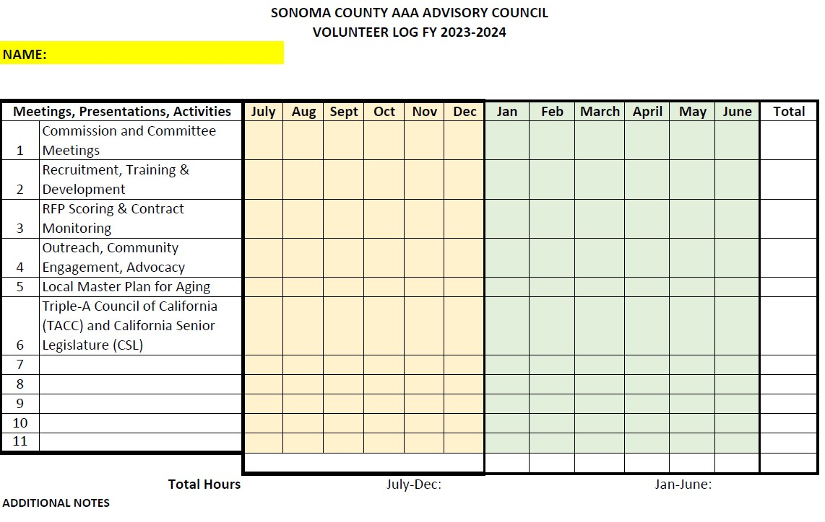
Volunteer Hours Tracking
Track Your
Activities

Slide 33
Roles & Opportunities of Commission Members
Educate & Inform Yourself & Community Members about services and opportunities – strengthen understanding about services and partnerships (i.e. site visits, focus groups, review materials and resources provided by Staff etc.)
Influence Program Development by Sharing Experiences & Community Contacts with Staff;
Advocate for Policy, Funding, Programs that support older adults, adults with disabilities and caregivers throughout Sonoma County (Request education from Staff)
Maintain connection with Board of Supervisors
Share ADRH and (707) 565-INFO (4636) Cards and other materials provided by Staff.

Slide 34
Advocacy is needed from Commission Members
AAA staff can provide education and;
AAA Advisory Council members can advocate
AC Members are the voice for All older adults, adults with disabilities and caregivers throughout Sonoma County
verb (used with object),ad·vo·cat·ed, ad·vo·cat·ing.
to speak or write in favor of; support or urge by argument; recommend publicly: He advocated higher salaries for teachers.
Notes:
Highlight that staff is not allowed to advocate as public employees but can provide education so AC members can give voice to an issue.

Slide 35
Margaret Mead
“Never doubt that a small group of thoughtful, committed citizens can change the world. Indeed, it is the only thing that ever has.”
Notes:
We know that you are each that small group who can create positive change in our county.

Slide 36
Concept for strengthening advocacy
AAA staff:
  Identify priority issues affecting older adults / people with disabilities
  Develop education / fact sheet on issue
  Support Agenda development & Bring items to Commission for a position / action
  At Commission request, staff may develop advocacy recommendations
  Consult Commission on funding opportunities and when a provider is severely out of compliance
  Provide training at Commission request
Commission Members:
  Identify priority issues affecting older adults / people with disabilities
    By focusing on relevant conversations in their District or the County (i.e., committees, other council, calling a meeting with stakeholders)
  Request Community Services staff develop education / fact sheet on issue
  Bring items to Commission Meetings for a position statement / action
  Identify “how to advocate”
How Can
Staff Support
You?
Notes:
Formatting

Slide 37
Examples of Advocacy Opportunities
Board of Supervisors, City Council Meeting Public Comment
Elder Justice Coalition, Mental Health Board (Countywide)
City Council/Planning Commission (District-Level)
Los Cien, NAACP, AAPI, Generation Housing, Disaster Planning (Countywide)
Sonoma County Library, Promotores, Faith-Based, Education, Sonoma County Indian Health Program (SCIHP)
Transportation Committees such as Sonoma County Transportation Authority - SCTA (City/County)
Letter to the Editor in Local Papers & Press Democrat etc.
Local Senior Advisory Commissions, Mental Health Board, Continuum of Care Board, Senior Center Boards, Section on Aging, Rotary to cross-pollinate between Commission and Local efforts
Participate in funded programs – engage with participants
Grassroots Programs: Establish Ad Hoc in a shared area of interest
  Past Examples: Elder Protection Workgroup, Court Watch, Advance Care Planning, LGBTQIA+
How Do You
Want to Engage?

Slide 38
Thank you!
Questions?

